Slide 1
Subscriber Maintenance

Slide 2
Flow of Presentation
Definition of subscriber maintenance.
Submission of request by subscriber.
Screen shot for downloading S2-Form from CRA website.
Procedure to be followed by nodal office to capture various requests in CRA system.
Subscriber Shifting Process (Transfer Cases)
Other views

Slide 3
What is Subscriber Maintenance
It is a facility provided by CRA to subscribers, wherein he can request any changes in his Permanent Retirement Account (PRA). For example:
Changes in Personal Details
Changes in Bank Details
Changes in Nomination Details
Reissue of PRAN Card (Loss of PRAN card)
Reissue of IPIN/TPIN (Forgot IPIN)

Slide 4
How can a subscriber requests for Changes in PRAN (For Subscriber)
Go to www.npscra.nsdl.co.in
Download Subscriber Detail Change Form(S2 Form)
Submit it to respective PAO/CDDO

Slide 5
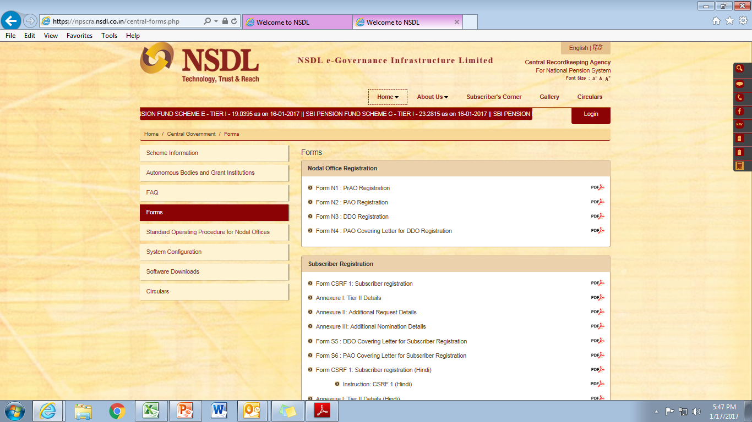
Screenshot to download S2 Form
Click on “ Form” to download S2 form

Slide 6
Procedures for Nodal Office (DTO) to submit various requests in CRA system
Request for Changes in Personal Details.
Login into the www.npscan-cra.com (NPSCAN System)
Enter Nodal Office User Id and Password (Given at the time of Registration in CRA system).
In case, of request of Changes in subscriber personal details
Go to Transaction Menu
Select Sub Menu: Update Subscriber Details
Enter PRAN of Subscriber

Slide 7
Cont…. Procedures for Nodal Office (PAO/CDDO) to submit various requests in CRA system
Click on Edit and Make changes
Click on confirm Button and Note down the 10 Digit Acknowledgement id
Login with the other User Id and Authorize the same. For example. USER ID 1002745600, PAO/CDDO has to capture the request with this user id and after capturing a request, he has to log out from the system and login with other USER ID10027456001,and authorize the respective request.

Slide 8
Change in Subscribers’ Details
Type of Request | Maker | Authoriser
Change in Personal & Bank Details (other than Core Data) | Yes | No
Change in Core Data | Yes | Yes
Change in Nomination Details | Yes | Yes
Change in Employment Details | Yes | Yes
Change in Scheme Preference | Yes | Yes
Reissue of I-Pin / T-Pin | Yes | Yes
Reprint of PRAN card | Yes | Yes

Slide 9
Introductory Screen

Slide 10
Changes in Personal details
Click on “Update Subscriber Detail”.

Slide 11
Changes in Personal details ..contd.
Insert PRAN

Slide 12
Changes in Personal details ..contd.
Click here to see subscriber details

Slide 13
Changes in Personal details.. ..contd.

Slide 14
Changes in Personal details ..contd.
Make Changes

Slide 15
Changes in Personal details ..contd.
Changes Initiated

Slide 16
Changes in Personal details ..contd.
Confirm the transaction

Slide 17
Changes in Personal details ..contd.
Acknowledgement No. generated

Slide 18
Changes in Personal details ..contd.
Click on “Authorise Transaction”
Login with second User id (Eg.Request captured with 1002728200), now login with second id 1002728201)

Slide 19
Changes in Personal details ..contd.
Click on “ Transaction Type”

Slide 20
Changes in Personal details ..contd.
Select” Subscriber Detail Change”

Slide 21
Changes in Personal details ..contd.
Enter Acknowledgement No.
Click on Search

Slide 22
Changes in Personal details ..contd.

Slide 23
Changes in Personal details ..contd.
Click on Authorise and then Submit

Slide 24
Changes in Personal details ..contd.
Message: “Subscriber Detail change has been accepted” PAO/CDDO can see changes by next day

Slide 25
Procedure for Reissue of IPIN/ PRAN card etc.
Click on Subscriber Maintenance and select the desired request form “ Sub Menu’s

Slide 26
Procedure for Reissue of IPIN/ PRAN card etc…contd.
Enter PRAN

Slide 27
Procedure for Reissue of IPIN/ PRAN card etc…contd.
Click here for IPIN

Slide 28
Procedure for Reissue of IPIN/ PRAN card etc…contd.
Click on Submit

Slide 29
Procedure for Reissue of IPIN/ PRAN card etc…contd.
Click on Confirm button

Slide 30
Procedure for Reissue of IPIN/ PRAN card etc…contd.
Acknowledgement Number generated

Slide 31
Procedure for Reissue of IPIN/ PRAN card etc…contd.
Login with other User id (eg.1002728201). Go to Subscriber maintenance and click on “ Authorise Reissue IPIN -TPIN

Slide 32
Procedure for Reissue of IPIN/ PRAN card etc…contd.
Enter User Id or PRAN or Acknowledgement number
Click on Search

Slide 33
Procedure for Reissue of IPIN/ PRAN card etc…contd.
Click here to see Expand

Slide 34
Procedure for Reissue of IPIN/ PRAN card etc…contd.
Click on Authorise
Click on submit

Slide 35
Procedure for Reissue of IPIN/ PRAN card etc…contd.
Authorisation message will appear

Slide 36
Procedure for Reissue of IPIN/ PRAN card etc…contd.
Click on Reprint PRAN

Slide 37
Procedure for Reissue of IPIN/ PRAN card etc…contd.
Enter PRAN and click Submit

Slide 38
Procedure for Reissue of IPIN/ PRAN card etc…contd.
Click on Confirm Button

Slide 39
Procedure for Reissue of IPIN/ PRAN card etc…contd.
Generation of Acknowledgement Number and message : Reprint request captured and awaiting verification

Slide 40
Procedure for Authorisation of Reissue of PRAN Card
Click on Sub Menu: Authorise Reprint PRAN

Slide 41
Procedure for Authorisation of Reissue of PRAN Card..contd.
Enter: Either PRAN or Acknowledgement Number and click on search

Slide 42
Procedure for Authorisation of Reissue of PRAN Card..contd.
Click on Acknowledgement Number to expand

Slide 43
Procedure for Authorisation of Reissue of PRAN Card..contd.
Click on “Authorize “ and submit

Slide 44
Procedure for Authorisation of Reissue of PRAN Card..contd.
Message : Reprint PRAN Request has been authorised

Slide 45
Procedure for Authorisation of Reissue of PRAN Card..contd.
Click on sub menu: Request Status View

Slide 46
Procedure for Authorisation of Reissue of PRAN Card..contd.
Select the Required Option, Enter Acknowledgement Number and click on Search Button

Slide 47
Procedure for Authorisation of Reissue of PRAN Card..contd.
Click on Acknowledgement Number to Expand

Slide 48
Procedure for Authorisation of Reissue of PRAN Card..contd.
Details of Captured request

